Slide 1
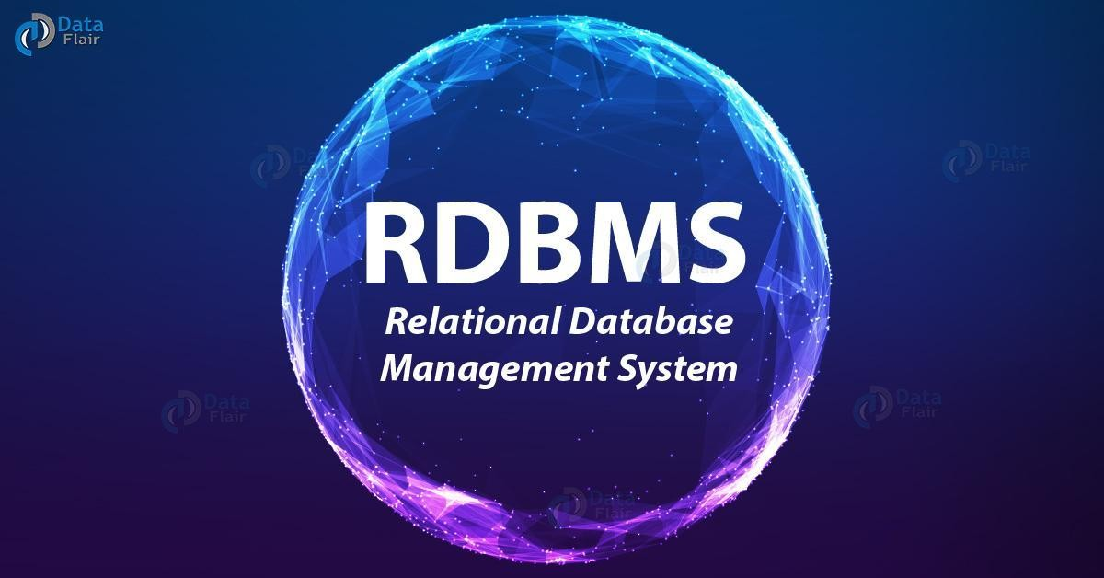

Slide 2
What is Data?
Data is a collection of a distinct small unit of information. It can be used in a variety of forms like text, numbers, media, bytes, etc. it can be stored in pieces of paper or electronic memory, etc.
Word 'Data' is originated from the word 'datum' that means 'single piece of information.' It is plural of the word datum.
What is Database?
A database is an organized collection of data, so that it can be easily accessed and managed.
organize data into tables, rows, columns, and index it to make it easier to find relevant information.
here are many dynamic websites on the World Wide Web nowadays which are handled through databases.
There are many databases available like MySQL, Sybase, Oracle, MongoDB, Informix, PostgreSQL, SQL Server, etc.
SQL or Structured Query Language is used to operate on the data stored in a database

Slide 3
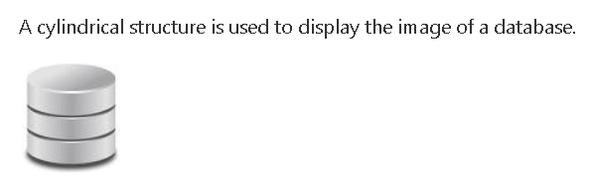
The database has completed more than 50 years of journey of its evolution from flat-file system to relational and objects relational systems. It has gone through several generations.
The Evolution
File-Based
1968 was the year when File-Based database were introduced. In file-based databases, data was maintained in a flat file.
Though files have many advantages, there are several limitations.
One of the major advantages is that the file system has various access methods, e.g., sequential, indexed, and random.
It requires extensive programming in a third-generation language such as COBOL, BASIC.

Slide 4
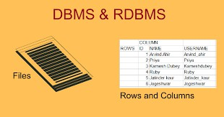
The RDBMS is a general-purpose software system that facilitates the processes of defining, constructing, manipulating, and sharing databases among various users and applications.

Slide 5
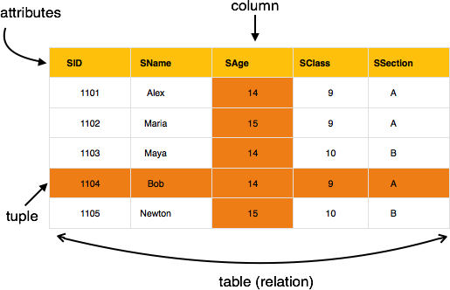
A relational database refers to a database that stores data in a structured format, using rows and columns. This makes it easy to locate and access specific values within the database. It is "relational" because the values within each table are related to each other. Tables may also be related to other tables. The relational structure makes it possible to run queries across multiple tables at once.

Slide 6
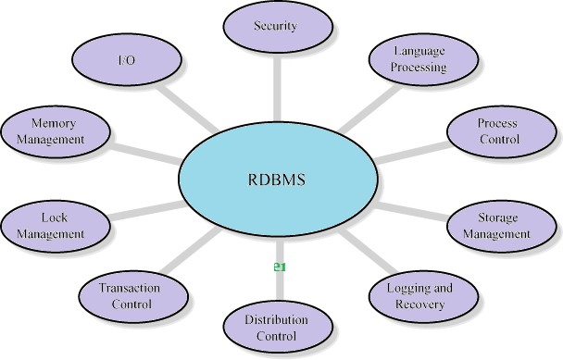
Features of RDBMS

Slide 7
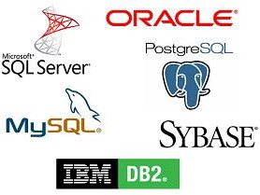
RDBMS TOOLS

Slide 8
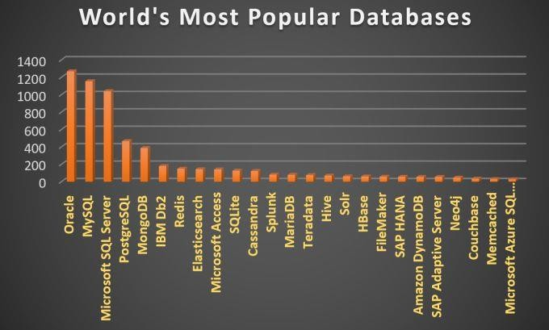
MOST POUPULAR RDBMS TOOLS

Slide 9
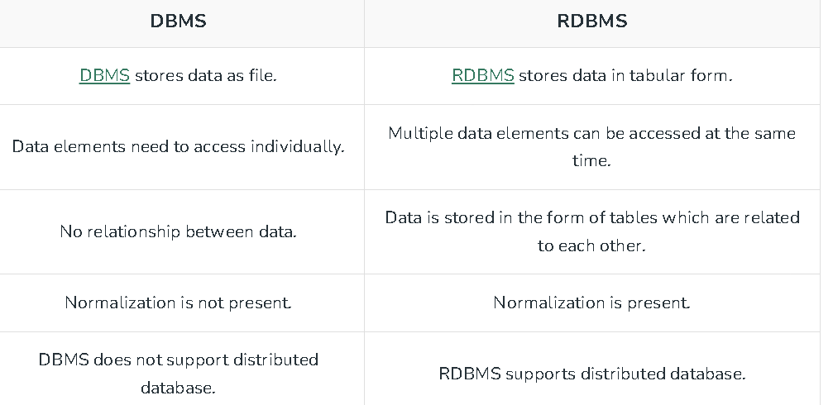

Slide 10
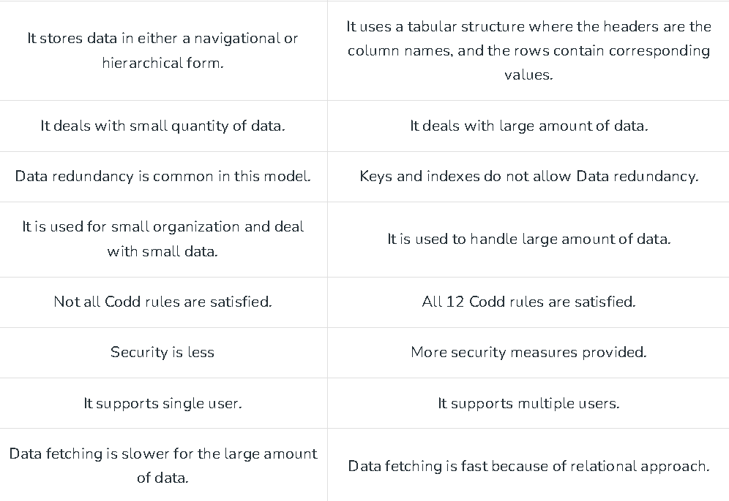

Slide 11
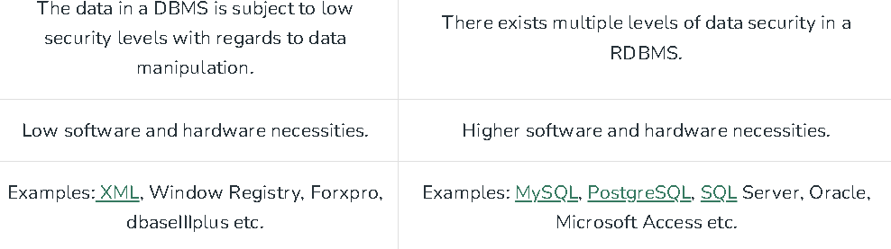

Slide 12
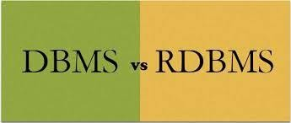
S.NO. | DBMS | RDBMS
1 | DBMS stands for Database Management System. | RDBMS stands for Relational Database Management System.
2 | DBMS offers an organized way of storing, managing and retrieving information. | RDBMS provides all features of DBMS with an added referential integrity concept.
3 | In DBMS, data is stored as a file. | In RDBMS, data are stored in a tabular form.
4 | In DBMS, there is no relationship concept. | RDBMS is used to build up the relationship concept between two database objects, i.e., tables
5 | DBMS supports single user only. | RDBMS supports multiple users.
6 | DBMS treats data as files internally. | RDBMS treats data as tables internally.
7 | In DBMS, there is no security of data. | In RDBMS, there are multiple levels of security, at logging level, at the command level, at the object level.

Slide 13
Purpose of Database Systems
Database management systems were developed to handle the following difficulties of typical file-processing systems supported by conventional operating systems.
Reduce Data redundancy and inconsistency.
Reduce Difficulty in accessing data.
Reduce Data isolation – multiple files and formats.
Reduce Integrity problems.
Concurrent access by multiple users
Reduces Security problem.
•

Slide 14
Advantages of RDBMS
1. Data Structure
They organize data into tables with rows and columns, providing a structured and consistent way to store and manage data.
This structure facilitates easy access, retrieval, and manipulation of data.
2. Data Integrity
They enforce data integrity through constraints, such as primary keys, foreign keys, and unique constraints.
preventing the introduction of duplicate or invalid information.
3. Data Relationships
They enable the establishment of relationships between tables using primary and foreign keys..
4. Querying and Reporting
They provide powerful query languages (e.g., SQL) that allow users to retrieve specific data from the database quickly.

Slide 15
5. Data Security
They offer security mechanisms to protect sensitive data.
Access control features allow administrators to define user permissions and restrict unauthorized access to data.
6. Scalability
They can handle large amounts of data and scale up to accommodate the growth of the dataset and user demand..
.
7. Data Backup and Recovery
They provide tools and mechanisms to perform regular backups of the database,
Enablling data recovery in case of hardware failures, accidental deletions
8. Data Indexing
They use indexing techniques to optimize data retrieval.
Indexes speed up query execution by reducing the need for full-table scans, especially for large datasets
9. Data Normalization
They encourage data normalization, which helps eliminate data redundancy and inconsistencies.

Slide 16
10. Data Consistency
They enforce referential integrity, ensuring that relationships between data remain consistent.
11. Data Independence
They offer data abstraction, separating the logical structure of the database from its physical implementation.
This data independence allows developers to modify the database schema without affecting the applications built on top of it.
12. Data Accessibility
They provide concurrent access to multiple users and applications.
13. Data Backup and Recovery
They typically offer various backup and recovery options
These features ensure data protection and the ability to restore the database to a specific point in time.

Slide 17
Video
https://in.video.search.yahoo.com/search/video?fr=mcafee&p=database+management+system+full+tutorial&type=E210IN885G0#id=3&vid=2132990446c6ad3a6980b14ad49c4f99&action=view

Slide 18
Review
Introduction to database
DBMS VS RDBMS
Advantages and Disadvantages
Next class
View of Data
Data models
Database models

